Slide 1


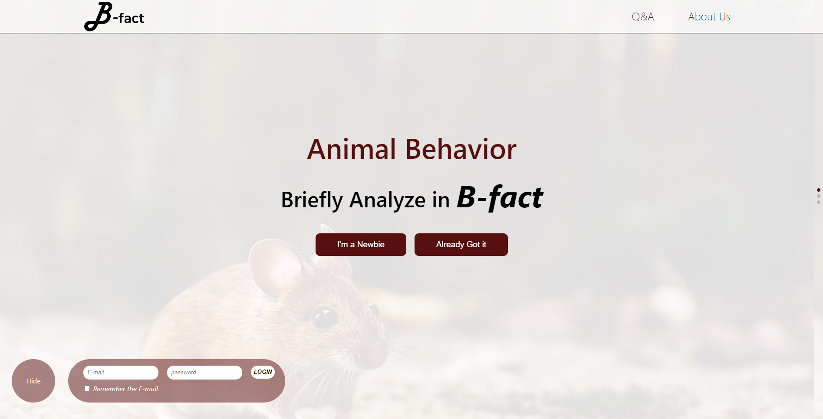








Title
AI 동물 행동 분석 프로젝트
박성준 20205075
권재용 20185016
Kohinur Akter 20201166
B-fact · 1

Slide 2
Chap
0
Index
목차
SW Development Plan
Problem·Marketability·Main Task·Prototype Model
2. Requirements
Analysis·Specification
5. Testing
Subtitle
3. SW Design
UML·Pipeline·Architecture
6. Maintenance
Subtitle
4. Implementation
Frontend·Backend·AI Model
B-fact · 2

Slide 3
Chap1
SW Development Plan
Problem
B-fact · 2

Slide 4
Chap1
SW Development Plan
Marketability
B-fact · 2

Slide 5
Chap1
SW Development Plan
Main Task
B-fact · 2

Slide 6
Chap1
SW Development Plan
Prototype Model
B-fact · 2

Slide 7
Chap2
Requirements
Analysis
B-fact · 7

Slide 8
Chap2
Requirements
Specification
B-fact · 8

Slide 9
Chap2
Requirements
Specification
B-fact · 9

Slide 10
Chap3
SW Design
UML
B-fact · 10

Slide 11
Chap3
SW Design
Pipeline
B-fact · 11

Slide 12
Chap3
SW Design
Architecture
B-fact · 12

Slide 13
Chap3
SW Design
Architecture
B-fact · 13

Slide 14
Chap4
Implementation
Front-end
B-fact · 14

Slide 15
Chap4
Implementation
Back-end
B-fact · 15

Slide 16
Chap4
Implementation
AI Model
B-fact · 16

Slide 17
Chap4
Implementation
Website
B-fact · 17

Slide 18
Chap5
Testing
Subtitle
B-fact · 18

Slide 19
Chap6
Maintenance
Subtitle
B-fact · 19

Slide 20
Chap7
Q&A
Subtitle
B-fact · 20

Slide 21
Chap7
Appendix.
B-fact · 21

